Slide 1
TEAM - 1 SOFTWARE ARCHITECTURE
"Architecture is about the important stuff. Whatever that is.“
Ralph Jhonson
Team:
Sandeep Kumar Sutharapu
Bhanu Prasad Kandula
Vyshnavi Reddy Mungi
Priyal Dharmendra Patel Pranavi Gunukula

Slide 2
Architectural Significant Requirements :
Data Sources & Types:
The primary source of data are sensors, and the data is sensor data, which encompasses various types of data collected.
Data Volume:
The data generated has a volume of 10 megabytes per second with minimal latency .
Real-time data ingestion and processing capabilities:
Probability that system doesn’t record any data or fails is less than 10^-4.
Probability that system doesn’t record specific message is less than 10^-6.
A strict zero-tolerance policy for data loss
Data insertion involves recording instances of bad data without elimination.

Slide 3
Architectural Significant Requirements :
Data Storage Requirements:
The preferred storage solutions are NO SQL Database.
Requirement is to store the data for the past 10 hours overwriting the old subsequent data if data exceeds storage space.
Adopting a first-in, first-out (FIFO) approach ensures that data is managed in a chronological order in queue.
Data Retrieval and Data Access:
The data retrieval within a timeframe of less than 30 minutes.
The data transfer is ATOMIC in nature implementing 0 or 100% retrieval.
The specific formats and protocols for data communication are detailed in the Interface Controlled Document (ICD), featuring extracted parameters, with a no raw messages.
The data transmission is through an Ethernet link.

Slide 4
Architectural Significant Requirements :
Security and Access Control Requirements:
The security and access control requirements involves the port used by maintenance personnel during flight must be disabled and enabled in post landing.
Access is restricted solely to authorized users.
No encryption is required.
Deployment and Maintenance:
Maintenance primarily involve regular updates and bug fixes to ensure ongoing system stability and performance.
Metrics:
Success measured by recording all data and checking CPU cycles

Slide 5
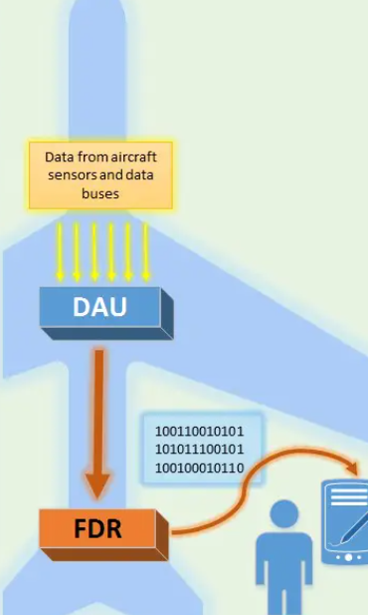
Summary Of System Functionality :
The real-time Flight Data Acquisition unit is designed for the aviation domain focusing on collecting, processing, storing, and retrieving sensor data. It supports data ingestion at a rate of 10 megabytes per second from primary source of sensors without eliminating bad data using a FIFO approach. The platform retains all data for the past 10 hours and ensures real-time processing. This system uses NoSQL data base to store a data of 360GB in a 512GB solid state Drive(SSD).This system adheres to Interface Controlled Document (ICD) specifications and uses an Ethernet link as the protocol for data retrieval only by an authorized person at a rate of retrieval 200 megabytes per second facilitating data retrieval in less than 30 minutes.
DAU: Data Acquisition Unit FDR: Flight Data Recorder

Slide 6
Data Storage Calculations WRT data receiver rate:
Total Data Stored=Data Rate × Time
Given: Data Rate = 10 megabytes per second (10 MB/s) Time = 10 hours
10 hours×60 minutes ×60 seconds =36,000 seconds
Total Data Stored=10 MB/s×36,000 seconds
Total Data Stored=360,000 MB
Therefore, at a rate of 10 megabytes per second over 10 hours, the total amount of data stored would be 360,000 megabytes (or 360 gigabytes).So, we need 360 GB of Data Storage Space.
Data Retrieval Rate Calculations:
Total data stored = 360,000 megabytes
The retrieval time required is 30 minutes.
30 minutes×60 seconds=1800
Now, to find the retrieval rate needed to fetch 360,000 megabytes within 1800 seconds:
Retrieval Rate=360,000 /1800 = 200
Retrieval Rate=200 megabytes per second
Therefore, to retrieve 10 hours of data (360,000 megabytes) within 30 minutes (1800 seconds), a retrieval rate of approximately 200 megabytes per second would be needed.

Slide 7
Quality Attributes and the Functions Driving Them:
Reliability: The system's ability to maintain continuous operation even in the face of component failures or disruptions.
The system is available to sensors mid flight for data ingestion and accessible to the retrieval personnel post landing, minimizing downtime and ensuring continuous operation.
Performance: The system's ability to process data efficiently and swiftly, minimizing response times and delays.
The system minimizes delays between data reception and processing, ensuring promptly storing and retrieving the data.
Security: The system's ability to protect sensitive aviation data from unauthorized access, breaches, or modifications.
The system implements appropriate security measures, including authorization mechanisms, to safeguard sensitive data.
Scalability: The system's ability to handle high volume of data
Dynamically manage the processing of sensor data regardless of the number of sensors.
Maintainability: The system's ease of understanding, modification, and adaptation to evolving requirements.
The system is structured into modular components, facilitating easily modifiable structure during bug fixes and updates.
Notes:
₌

Slide 8
Overall Architecture:
The overall architecture of the system is a hybrid approach that combines Event-Driven Architecture (EDA) principles with Microservices Architecture.
This high-level Architecture categorizing the microservices as an EDA components such as event producers, Ingestion components, consumers.
The low-level Architecture focuses on the individual microservice implemented within each EDA component.
Each Microservice “is-a” sub module of EDA component defining the Module Structure.
Each micro service can be a single micro service or combination of micro service called composite microservice or a coarse-grained microservice
Data receiver and processor micro service is a composite microservice or a coarse-grained microservice which is a combination of Data Receiver microservice and Event Processor microservice.
Data retrieval and Access Control Microservice is a composite microservice of combining Data Retrieval microservice and Access Control microservice.
Storage Management Micro Service is a composite microservice of combining Monitoring microservice and Storage Management microservice.

Slide 9
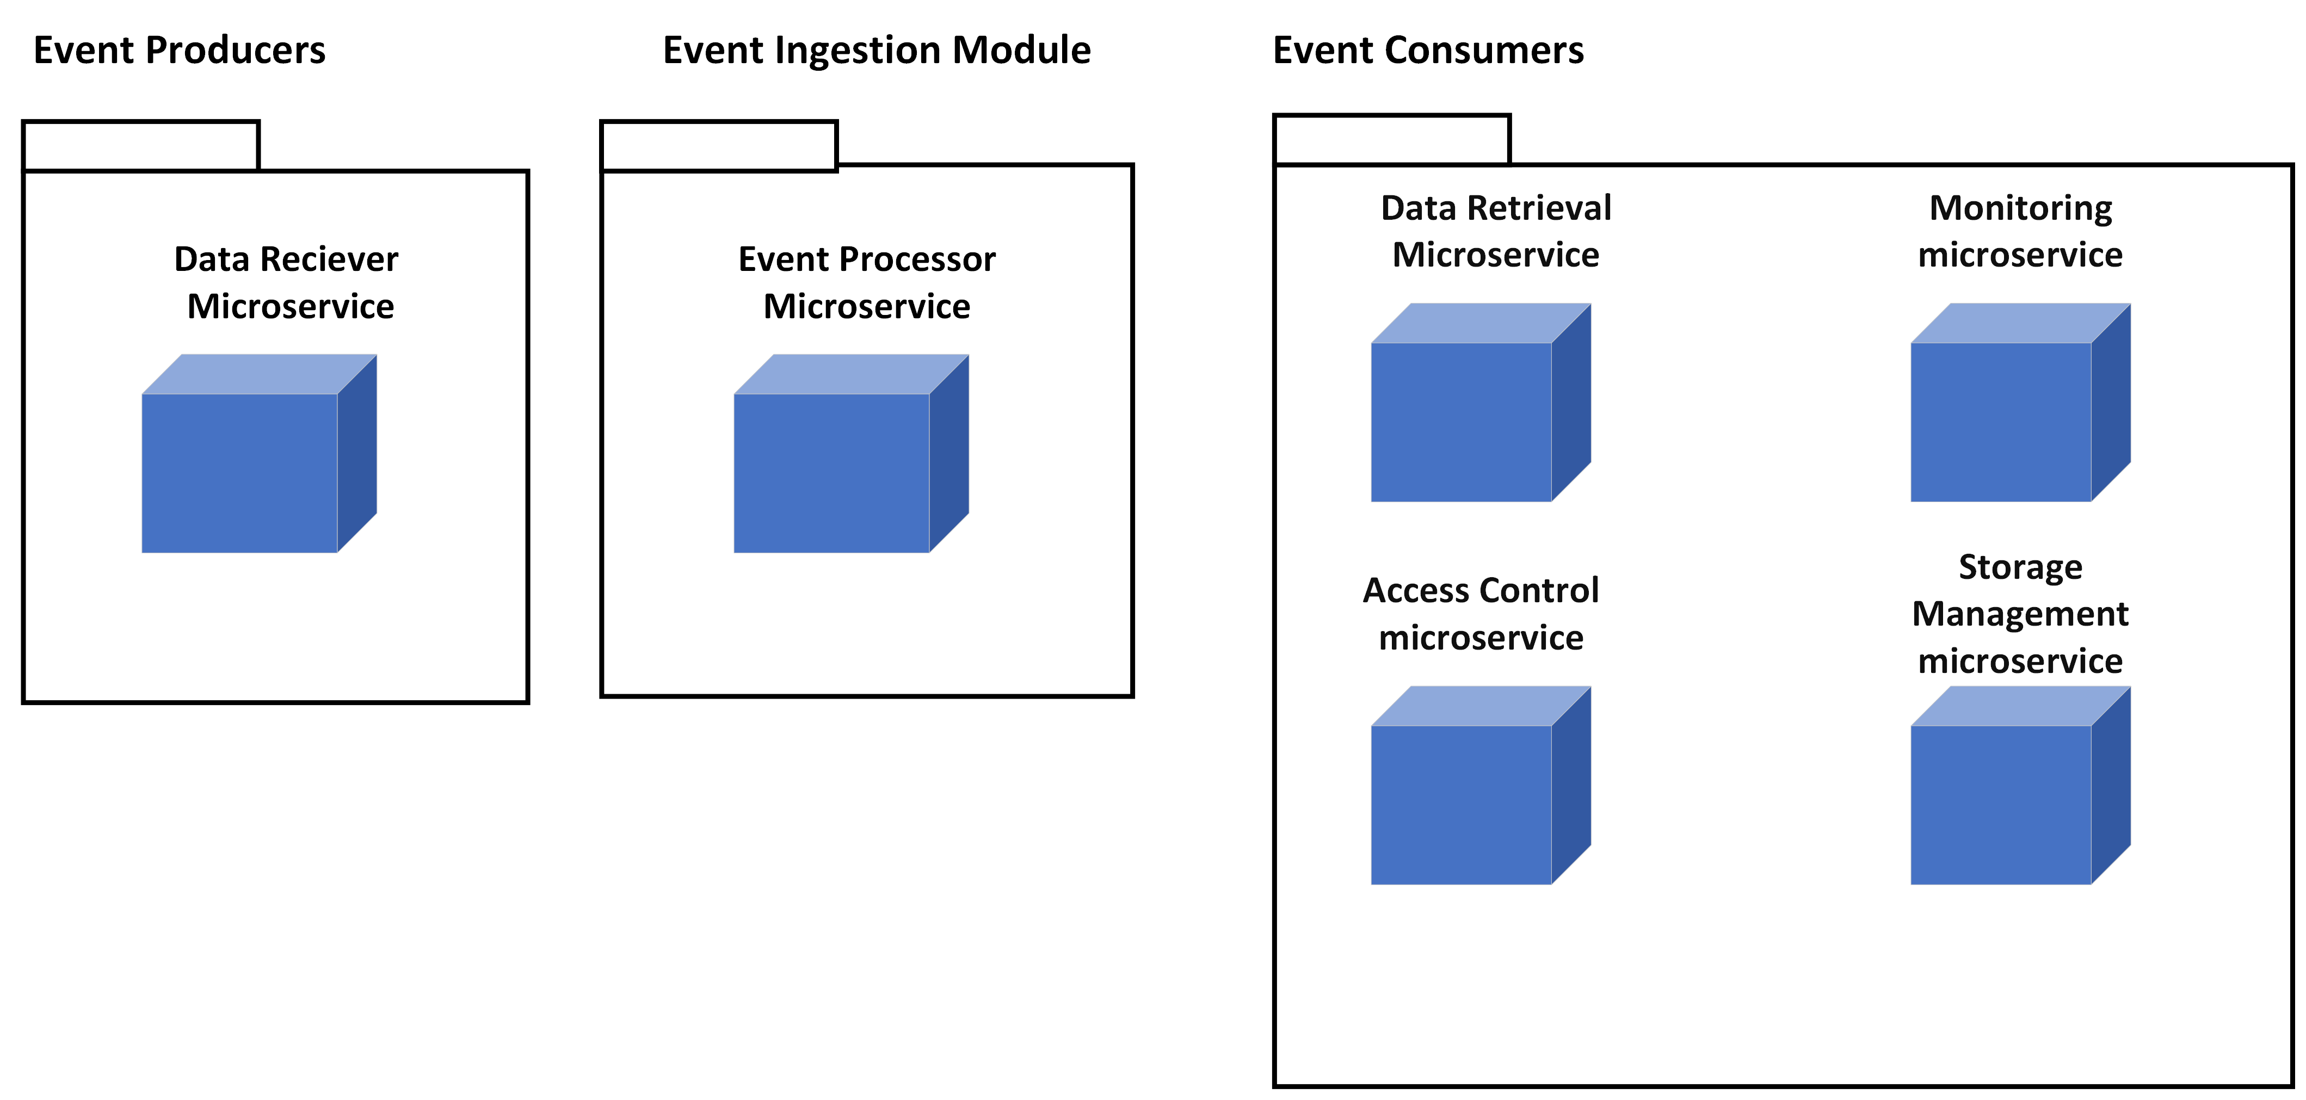
Event-Driven Architecture (EDA) in Development View and Module Structure:
Event Producers:
Data receiver microservice
Event Ingestion:
Event processor microservice
Event Consumers:
Data Retrieval microservice
Access Control microservice
Monitoring microservice
Storage Management microservice.

Slide 10
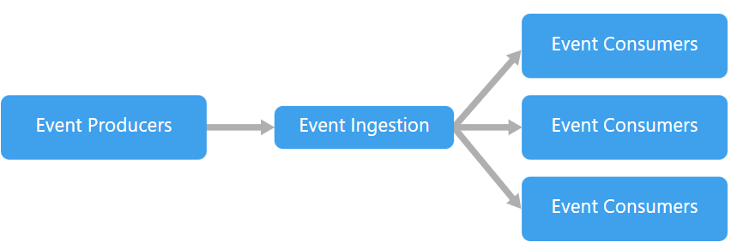
Microservices Architecture In Logical View:
Data Receiver and Processor Microservice:
Acts as an Event Streaming Service directly coupled with sensors.
Continuously receives, processes and transforms incoming sensor data based on predefined rules.
Process the ingestion enqueues to FIFO queue in shared location.
Storage Management Microservice:
Constantly monitors the shared memory flag and FIFO queue as sources for consumption .
Dequeues and store the data into the NoSQL database extending up to 10 hr’s.
Overwriting the data on time frequency exceeding 10 hr’s leaving space for new data.
On retrieval Enqueues the data from NoSQL into queue.
On 100% completion of data retrieval process than deletes the data in data base.
3. Data Retrieval and Access Control Microservice:
Acts as Access control Authenticator facilitating ethernet port.
Acts as data retrieval brokerage service from shared memory, Dequeues the data from the shared memory FIFO queue.
Transforms and returns the data in native format with extracted parameters and process the retrieval.

Slide 11
Microservices Architecture In Process View:
Data Receiver and Processor Microservice:
Turns the flag in the shared memory to blue at the start of the data insertion process.
Enqueues the produced events into the FIFO queue located in the shared memory for data processing.
Persists the blue flag in shared memory until the data insertion process concludes and turns the flag into red at the end of the data insertion process.
Storage Management Microservice:
a) Actions During Flight:
Monitors the blue flag in the shared memory as a signal for the ongoing data insertion process.
Detects and dequeues new events enqueued by the Data Receiver and Processor Microservice in the FIFO queue.
Performs storage actions, storing the event data into the NoSQL database based on the processed events.
Maintains the 10 hours data persistence by overwriting the old data.
b) Actions Post Landing:
After landing, the Storage Management Microservice expands its role beyond data insertion to facilitate retrieval.
On ethernet human retrieval trigger, retrieves the information from NoSQL and insert the data into queue.
Once the 100% transaction of data retrieval is completed then and only system completely deletes the data.
Makes sure that the transaction is Atomic in nature, Turns the flag to red on completing the retrieval.
3. Data Retrieval and Access Control Microservice:
Consumes the event triggered for retrieval from human.
Handles access control and authentication post-landing by authorized personnel.
Turns the flag in shared memory to green , Initiates the data retrieval process and completes.
Any interruption while transaction eliminates the data inside the retrieved system and persist 0% of data retrieval.

Slide 12
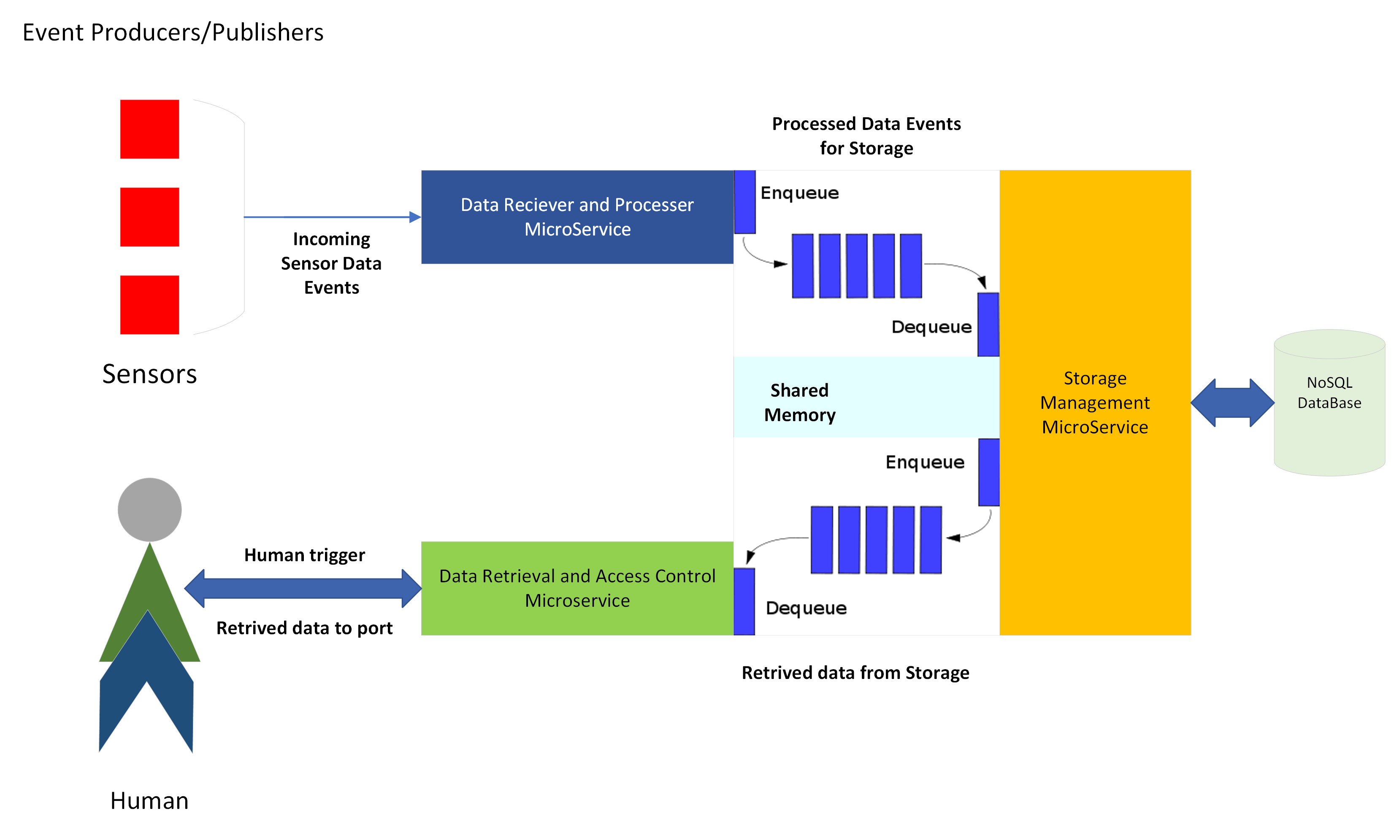
Process / Flow Diagram:

Slide 13
Performance
System Description:
The Data Receiver and Processor Microservice efficiently ingests data from sensors at up to 10 megabytes per second, utilizing a low-latency data ingestion pipeline.
It processes ingested data in real-time using parallel processing and data streaming techniques, employing a NoSQL database optimized for high-performance data insertion and retrieval.
The Data Retrieval and Access Control Microservice retrieves data from storage at up to 200 megabytes per second, leveraging a low-latency data retrieval pipeline.
The Storage Management Microservice stores data on a 512GB solid-state drive (SSD), ensuring high-performance data storage and retrieval to meet data ingestion and retrieval requirements.
Overall Architecture Performance
The overall architecture of the system is designed to be highly performant. The use of a hybrid approach that combines Event-Driven Architecture (EDA) principles with Microservices Architecture allows the system to process the sensor data efficiently. The microservices also use a modular design that makes them easy to test and deploy.

Slide 14
Tactics:
Control Resource Demand
Bound Execution Times: This tactic is relevant to all three microservices, as it can help to prevent runaway processes that could overload the system. By setting a limit on how long each event can be processed, validated as per ICD, the microservices can ensure that resources are not being consumed by a single event for an extended period of time.
Manage Resources
Introduce Concurrency: This tactic is relevant to all three microservices, as it can improve throughput by allowing multiple events to be processed concurrently. By using techniques such as asynchronous processing and thread pooling, the microservices can handle more events simultaneously, reducing overall processing time.
Bound Queue Sizes: This tactic is relevant to all three microservices, as it can help to prevent queue overflow, which can lead to data loss. By bounding the size of queues, the microservices can ensure that they have enough memory to store incoming events, even during periods of high demand.
Pattern:
The MapReduce pattern could be used for the Data Receiver and Processor Microservice to efficiently process the large volume of data it receives from the sensors. The map phase could transform the sensor data into key-value pairs, and the reduce phase could aggregate the data based on the keys. This would allow the microservice to process the data in parallel and reduce the overall processing time.

Slide 15
Trade Off:
While the hybrid approach allows for vertical scalability and flexibility, it introduces complexity in terms of managing interactions between microservices. Additionally, there might be a trade-off between the benefits of microservices (e.g., modularity) and the challenges of coordinating events across services.
Introducing concurrency improves throughput, it also introduces complexity in terms of handling race conditions, ensuring data consistency, and managing shared resources. Excessive concurrency might lead to contention and performance degradation. This could be mitagated by using optimistic locking techniques.

Slide 16
Security
The "Data Retrieval and Access Control Microservice" explicitly mentions handling access control and authentication for authorized personnel indicating a focus on authentication.
The use of an Shared memory helps our software to completely isolate from internet keeping the data stored and secured. We are not using any protocol based or socket based communication making the process more secure
The microservices manages flags in shared memory to control processes. The ability to control flags (red, green, or blue) indicates mechanism monitored by data storage and management service to switch between the processes. This flag mechanism alters the read and write access of the services.
When data ingestion process is on (flag is blue) the system shared memory enables write access of queue to data receiver and processing service and enables read access to S & M service .When the flag is green the system shared memory enables write access to S & M service and enables read access to Data retrieval and success control microservice .
The system relies on an Ethernet link as the protocol for data retrieval. It's important to ensure that the data transmitted over the network is secure.
The emphasis on atomic transactions, especially during data retrieval and insertion, contributes to ensuring the integrity and security of the data.

Slide 17
Patterns and Tactics:
Authentication and Access Control:
Pattern: Role-Based Access Control (RBAC)
Implement RBAC to define and enforce roles and permissions for different system components and users. This ensures that only authorized personnel have access to specific functionalities.
Flag Mechanism and Shared Memory Control:
Pattern: State Machine Pattern
Use a state machine pattern to manage the different states of the flag (red, green, or blue) in shared memory. Define transitions and enforce access controls based on the current state to regulate data processing phases securely.
Atomic Transactions:
Pattern: Two-Phase Commit
Implement the Two-Phase Commit pattern to ensure atomic transactions during data retrieval and insertion. This pattern guarantees that either all operations are completed successfully or none at all, maintaining data integrity.

Slide 18
Trade off :
The decision to keep the system isolated from external networks enhances security but may limit accessibility for certain maintenance or monitoring tasks.
Ensuring atomic transactions during data retrieval and insertion contributes to data integrity but may impact processing performance quality attribute , especially during high transaction rates.

Slide 19
Scalability
Critical Component : Data Receiver and Processor Micro Service.
Scalability comes into the picture while managing sensor data efficiently, When multiple number of sensors serving a common functionality .
Example : receiving the Altitude or Thrust information from 100 sensors producing 1000 mb of data or 3 sensors producing 30 MB of data.
The system should dynamically manage the processing of sensor data without depending on number of sensors.
The event streaming service platform implements dynamic resource allocation, adjusting CPU, memory, and storage resources within the same instance based on real-time workload demands, basically undergoing vertical scaling.
The scalable factor of the architectural Flight Data Acquisition unit ensures that it can efficiently handle the increasing data volume generated by sensors.
Having a NoSQL database always gives an option for storage scaling. Any how maintaining 10 hours of data in the storage eliminating the old data is a functionality that removes the scope of scalability in Storage Management and Data Retrieval -Access Control microservices.

Slide 20
Tactics and Patterns:
Shared-nothing Architecture using Micro Services:
Designing systems where each component operates independently, minimizing dependencies and allowing easier scaling.
Parameterized Resource Scaling:
The system defines parameters for scaling resources within the same instance, allowing for fine-tuned adjustments to CPU, memory, and storage allocations.
Voting/Load Balancing Mechanism:
Implementing load balancing mechanisms to manage duplicated sensor data to minimize workloads.
If same value of data is received from “n” no of common serving sensors is taken as 1 single value.
Here the bad data out of sensor is considered as a unique value making sure that bad data is not eliminated.
Load Balancing = All the sensor’s data/ No of Sensors
Example: If 3 altitude sensor give me a value of 10 Km each.
S1= 10,S2=10,S3 =10
LB = S1+S2+S3/3=>30/3=10
Efficient Queue Handling:
Optimize FIFO queue handling for data processing, leveraging scalable message queuing systems

Slide 21
Trade Off:
Dynamic resource allocation during vertical scaling may require instances to temporarily go offline for adjustments. Sacrificing immediate availability for the sake of accommodating increased processing demands.
Designing for scalability may introduce architectural complexities, such as the need for load balancing, distributed data management. Managing the increased complexity while ensuring the system remains maintainable.

Slide 22
Reliability
Probability that system doesn’t record any data or fails is less than 10^-4.
Probability that system doesn’t record specific message is less than 10^-6.
The system enforces a strict zero-tolerance policy for data loss. Reliability questions system's ability to maintain continuous operation even in the face of sensor failures or disruptions during data ingestion.
During retrieval process reliability emphasis on atomic transactions making sure that the system guaranteeing that either all operations are successfully completed, or none at all.
The First-In-First-Out (FIFO) queue implemented in shared memory ensures a reliable and orderly processing of events.

Slide 23
Tactics and Patterns:
Exception Handling: (On error Continue Scope) The errors (inaccurate data from sensor) are handled in a way that the bad or failure event are parsed as same a successful event. Making sure that system is not missing any bad data.
Timestamp: This is a distributed message-passing system. As sensor data passing through Receiver and Processing micro service is assigned a system time stamp to ensure sequence of operations. This tactic is used to detect incorrect sequences of events.
Redundancy by flag mechanism: While data retrieval process the flag is turned off only when the 100% data transaction is completed making the system highly reliable on Atomic nature.
Fault Isolation and Containment: Using EDA and microservices inherently provides fault isolation making sure that failures in one part of the system don't propagate to other components as failures. Events act as independent messages, allowing for fault isolation and containment.
Redundancy in Storage Management: System uses redundancy in the storage approach by overwriting old data if storage space exceeds its limit, enabling consistent data availability for the past 10 hours
Queue Mechanism: Basically, queue implementation adheres to Queue + DLQ(Dead Letter Queue) Mechanism, where DLQ captures the failed event but in this system the failures are not differentiated form successful events making stand alone FIFO queue reliable on enqueue and dequeue the events without filtering.

Slide 24
Trade offs
Reliability vs. Performance:
Overemphasis on reliability tactics might impact system performance. Ensuring high reliability through redundant mechanisms and atomic transactions might introduce additional processing overhead, potentially impacting the system's overall performance or responsiveness.
Reliability vs. Storage Efficiency:
Overwriting old data to ensure availability for a specific duration might sacrifice the storage of potentially valuable historical information, impacting storage efficiency. But the requirement elicitation has reasoned that it is fine to remove old data.

Slide 25
Maintainability
Maintainability comes into picture when there is a Future update ,bug fixes or any ICD formats change.
Microservices architecture provides a modular approach, breaking down the system into independently deployable services. This separation of concerns allows each microservice to focus on specific functionality, promoting maintainability by isolating changes to individual components.
The adherence of the aviation data acquisition system to Interface Controlled Document (ICD) documentation ensures standardized communication protocols in which Modifiability plays a significant role by enabling easy updates and modular changes to respond to dynamic aviation requirements and new technologies.
Adopting NoSQL storage improves modifiability by reducing bug issues related to storage capacity monitoring and deletion mechanisms. This ability to change ensures that the system meets data retention standards while maintaining performance throughout changes.

Slide 26
Tactics and Patterns:
Modular Microservices Architecture:
Breaking down the system into discrete microservices (e.g., Data Receiver and Processor, Storage Management, Data Retrieval and Access Control) promotes maintainability. Microservices allow independent development, deployment, and maintenance of each component. Modifications or updates to a single microservice won't affect the entire system, enhancing maintainability.
Event-Driven Architecture (EDA) Principles:
Leveraging EDA concepts (event processors, consumers) to handle events and interactions between microservices. EDA fosters loose coupling between components, enabling easier maintenance by decoupling event producers from consumers. Changes in one component's behavior won't heavily impact others, ensuring maintainability.
Composite Microservices and Coarse-Grained Services:
Employing composite microservices or coarse-grained services like the Data Receiver and Processor Microservice combining multiple functionalities. Combining functionalities into a single service promotes maintainability by reducing complexity, and dependencies, and simplifying maintenance tasks and updates.
Atomic Transactions and Data Deletion Strategies :
Implementing atomic transactions during data retrieval and controlled data deletion post-retrieval. Atomic transactions ensure data consistency and reliability, while controlled data deletion strategies provide maintainability by facilitating efficient and controlled removal of outdated data.

Slide 27
Trade offs
Maintainability Vs Performance
Having a well separated microservices enhances system maintainability.
At the same time implementing communication between micro services will optimize for performance.

Slide 28
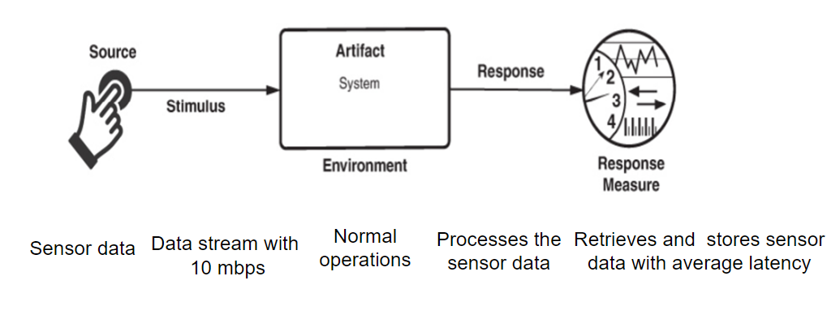
QA Scenarios : Performance Scenario : Retrieve and store sensor data with average latency
Portion of Scenario | Description | Possible Values
Source | Real-time data from aircraft sensors | Sensor data
Stimulus | Continuous and high-volume data stream from aircraft sensors | Demand for informed decisions about efficiently processing the sensor data.
Artifacts | Microservices architecture, Event-Driven principles, and Ethernet link | Microservices Architecture: decomposes the system into small, independent services Event-Driven Architecture: decouples services and enables asynchronous communication High-Speed Ethernet Link: ensures that data can be retrieved from sensors quickly Processor Selection: crucial for handling the high-volume data stream Processor Recommendations: Intel Core i5-12600K, AMD Ryzen 5 5600X, Apple M1 Max Data Retrieval Time: achievable within the specified requirements

Slide 29
QA Scenarios : Performance
Portion of Scenario | Description | Possible Values
Environment | The system is under normal operation. | High-volume, real-time data streams from aircraft sensors and need for minimal latency in data processing
Response | System's ability | Ability to process and analyze real-time sensor data at a rate of 10 megabytes per second with minimal latency
Response measure | Metrics | System's ability to maintain its throughput and latency metrics within acceptable tolerances

Slide 30
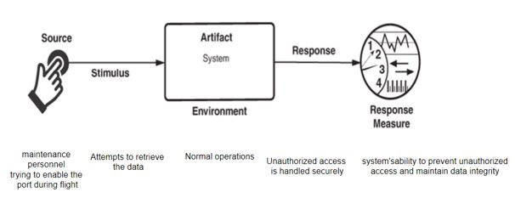
QA Scenarios : Security Scenario : System's ability to prevent unauthorized access and maintain data integrity
Portion of Scenario | Description | Possible Values
Source | Aircraft sensor data | Need to protect sensitive aviation data from unauthorized access or manipulation
Stimulus | Presence of maintenance personnel who may need access to the system for troubleshooting or updates | Demand for informed decisions about access and maintenance
Artifacts | System's architecture and security mechanisms, including Access Control Microservice and port disabling during flight | Access Control Microservice Port Disabling during Flight Secure Coding Practices Regular Security Audits and Penetration Testing
Environment | The system is under normal operation. | Presence of maintenance personnel and need to protect sensitive aviation data
Response | System's ability | Ability to protect aviation data from unauthorized access or manipulation, even in the presence of maintenance personnel
Response measure | Metrics | System's ability to prevent unauthorized access, maintain data integrity, and ensure data availability

Slide 31
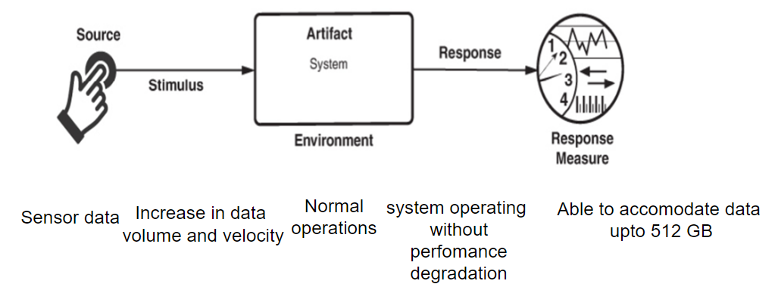
QA Scenarios : Scalability Scenario : Able to accommodate data upto 512 GB
Portion of Scenario | Description | Possible Values
Source | Continuous growth of the data | Growing need for real-time data from the flight sensors
Stimulus | The system receives an increased volume of data. | Accomodating the data to the maximum extent
Artifacts | System's architecture and technology stack (microservices architecture and NoSQL databases) | Microservices Architecture Loose Coupling Fault Isolation NoSQL Databases Data Partitioning Schema Flexibility Vertical Scalability
Environment | The system is under normal operation. | High-volume, real-time data streams from aircraft and other sources
Response | System's ability | Accommodate future growth in data volume without impacting performance or availability.
Response measure | Metrics | System's ability to maintain its performance and availability metrics as data volume and velocity increase (throughput, latency, and error rates)

Slide 32
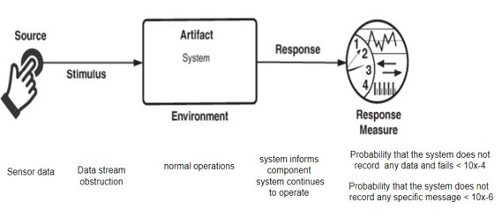
QA Scenarios : Reliability Scenario : Probability that the system does not record any data and fails < 10^-4 and Probability that the system does not record any specific message < 10^-6
Portion of Scenario | Description | Possible Values
Source | Critical nature of aviation data | Real-time data streams from aircraft sensors, potential hardware failures, and software errors
Stimulus | The system receives an increased volume of data, and the probability of missing data | Ensuring the system to be reliable with the sensor data
Artifacts | System's architecture and technology stack (EDA, Microservices, Storage Management Microservice, atomic data retrieval transactions) | EDA: Decoupling, asynchronous communication, and resiliency Microservices: Small, independent services, service boundaries Storage Management Microservice: Data integrity and availability Atomic data retrieval transactions: Data consistency and accuracy Preventing System Failure Redundancy and Fault Tolerance Fail-Safe Mechanisms Comprehensive Monitoring and Alerting Thorough Testing and Validation Continuous Improvement and Maintenance Preventing Specific Message Loss Reliable Data Transmission Message Logging and Retransmission Acknowledgment and Confirmation Mechanisms

Slide 33
QA Scenarios : Reliability
Portion of Scenario | Description | Possible Values
 |  | Error Detection and Correction Prioritization and Queuing Capacity Planning and Load Balancing
Environment | The system is under normal operation. | High-volume, real-time data streams from aircraft and other sources
Response | System's ability | Able to provide the results without impacting performance or availability.
Response measure | Metrics | Maintain performance and availability metrics within acceptable tolerances (MTBF, MTTR, data integrity metrics)

Slide 34
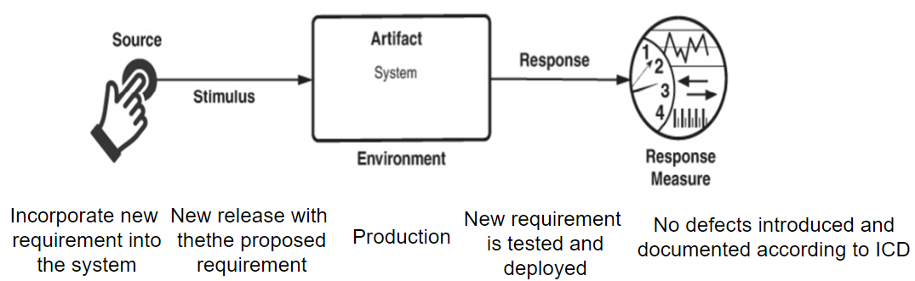
QA Scenarios : Maintainability Scenario : Incorporating new requirement into the system
Portion of Scenario | Description | Possible Values
Source | Aircraft data insertion and retrieval | Need for the system to adapt to new technologies and requirements
Stimulus | Continuous growth and complexity of aviation data | Demand for informed decisions about maintenance and deployment
Artifacts | Modular architecture (Microservices Architecture and separation of Data Insertion, Data Storage, Data Retrieval modules) | Microservices Architecture Documentation and Version Control Automated Testing Deployment and Maintenance Plans: Staging Environment Blue-Green Deployment Automated Deployment Continuous Monitoring Proactive Maintenance Incident Management
Environment | The system is under normal operation. | Rapid technological advancements and constantly evolving aviation regulations
Response | System's ability | The new service is tested and deployed
Response measure | Metrics | Ability to be modified and updated with minimal effort and impact on its overall functionality

Slide 35
Product Recommendations
Event Streaming Service:
Real-time distributed service to handle event streams with abstraction (Apache Kafka).
Continuous Data Processing:
Apache Flink a stream processing framework used to consume incoming data.
Combining Apache Kafka with Apache Flink to achieve low latency, high throughput and fault tolerance.
Monitoring Shared Memory and FIFO Queue:
APEX (ARINC 653) is an application software interface which allows data partitioning and has its own data memory space.
Grafana is a versatile monitoring and visualization tool that can integrate with various data sources, including monitoring specific aspects of shared memory.
RabbitMQ can efficiently handle the messaging requirements of a FIFO queue, ensuring reliable communication between components.
NoSQL Database Storage:
MongoDB supports the separation of data production and consumption by providing a flexible storage solution.

Slide 36
Product Recommendations
Task Scheduling for Data Deletion:
Integrate the logic responsible for data deletion based on defined time frequencies.
Flag Management and Queue Enqueuing:
Develop a component that handles flag management to add logic that turns the flag in the shared memory to either red, green or blue based on different services.
RabbitMQ supports an event-driven architecture without a strict one-to-one correspondence between components and modules.
Data Retrieval and Transformation:
The microservice, implemented using Node.js and Express, can easily interact with shared memory to turn the flag to green.
Atomicity and Authentication:
Keycloak is a flexible and open-source identity and access management solution, suitable for robust authentication.

Slide 37
Process Recommendations :
Prioritize QAs based on their significance to the overall system goals.
Implement redundancy in sensor systems to ensure data reliability and integrity, especially during critical flight phases.
Analyze data volume and usage patterns to determine minimum storage capacity. Plan for scalable storage solutions, ensuring minimum capacity requirements are met while considering retention policies.
Review and adhere strictly to ICD specifications during data formatting. Conduct thorough testing to ensure seamless integration and minimal issues.
Prioritize modular design for easy adaptability. Conduct periodic assessments for scalability, ensuring compatibility with evolving data volumes and sensor types
Ensure compliance with aviation regulatory standards regarding data collection, storage, and transmission adhering to ICAO (International Civil Aviation Organization) , FAA (Federal Aviation Administration).

Slide 38


